Slide 1


FINDING THE NOTES PRESENT IN GUITAR CHORD WITH THE HELP OF FAST FOURIER TRANSFORM
DSP
PROJECT 2018-2019
Subtitle

Slide 2
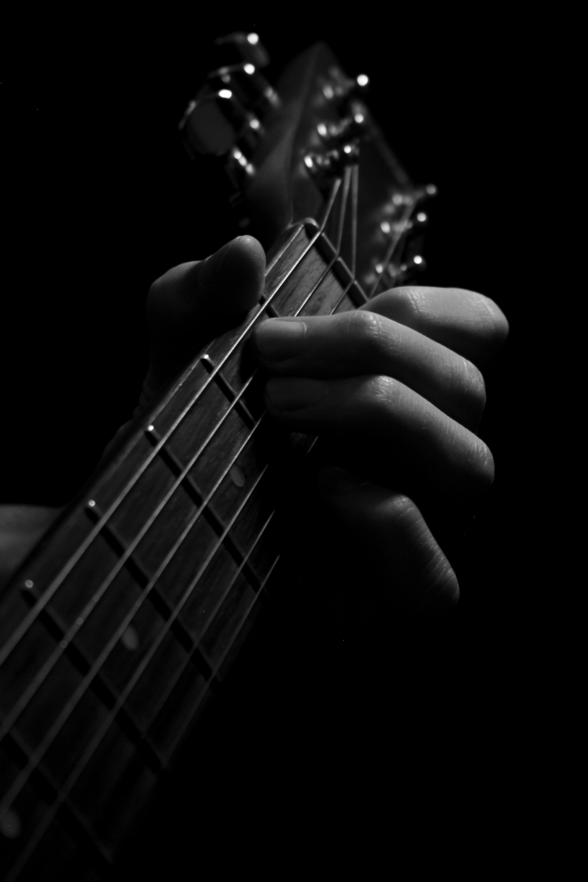
SUBMITTED BY : PRAKHAR PALIWAL
[EN17EL301101]
RISHABH JAIN
[EN17EL301115]
RAJAT PATIDAR
[EN17EL301109]
DSP
SUMBMITTED TO-
Mr. AMIT REGE
SR. ASSISTANT PROFESSOR
DIGITAL SIGNAL PROCESSING
PROJECT 2018-2019

Slide 3
Contents
Introduction
Relevant Theory
Objective
Methodology
Program code
Result
Conclusion
Bibliography

Slide 4
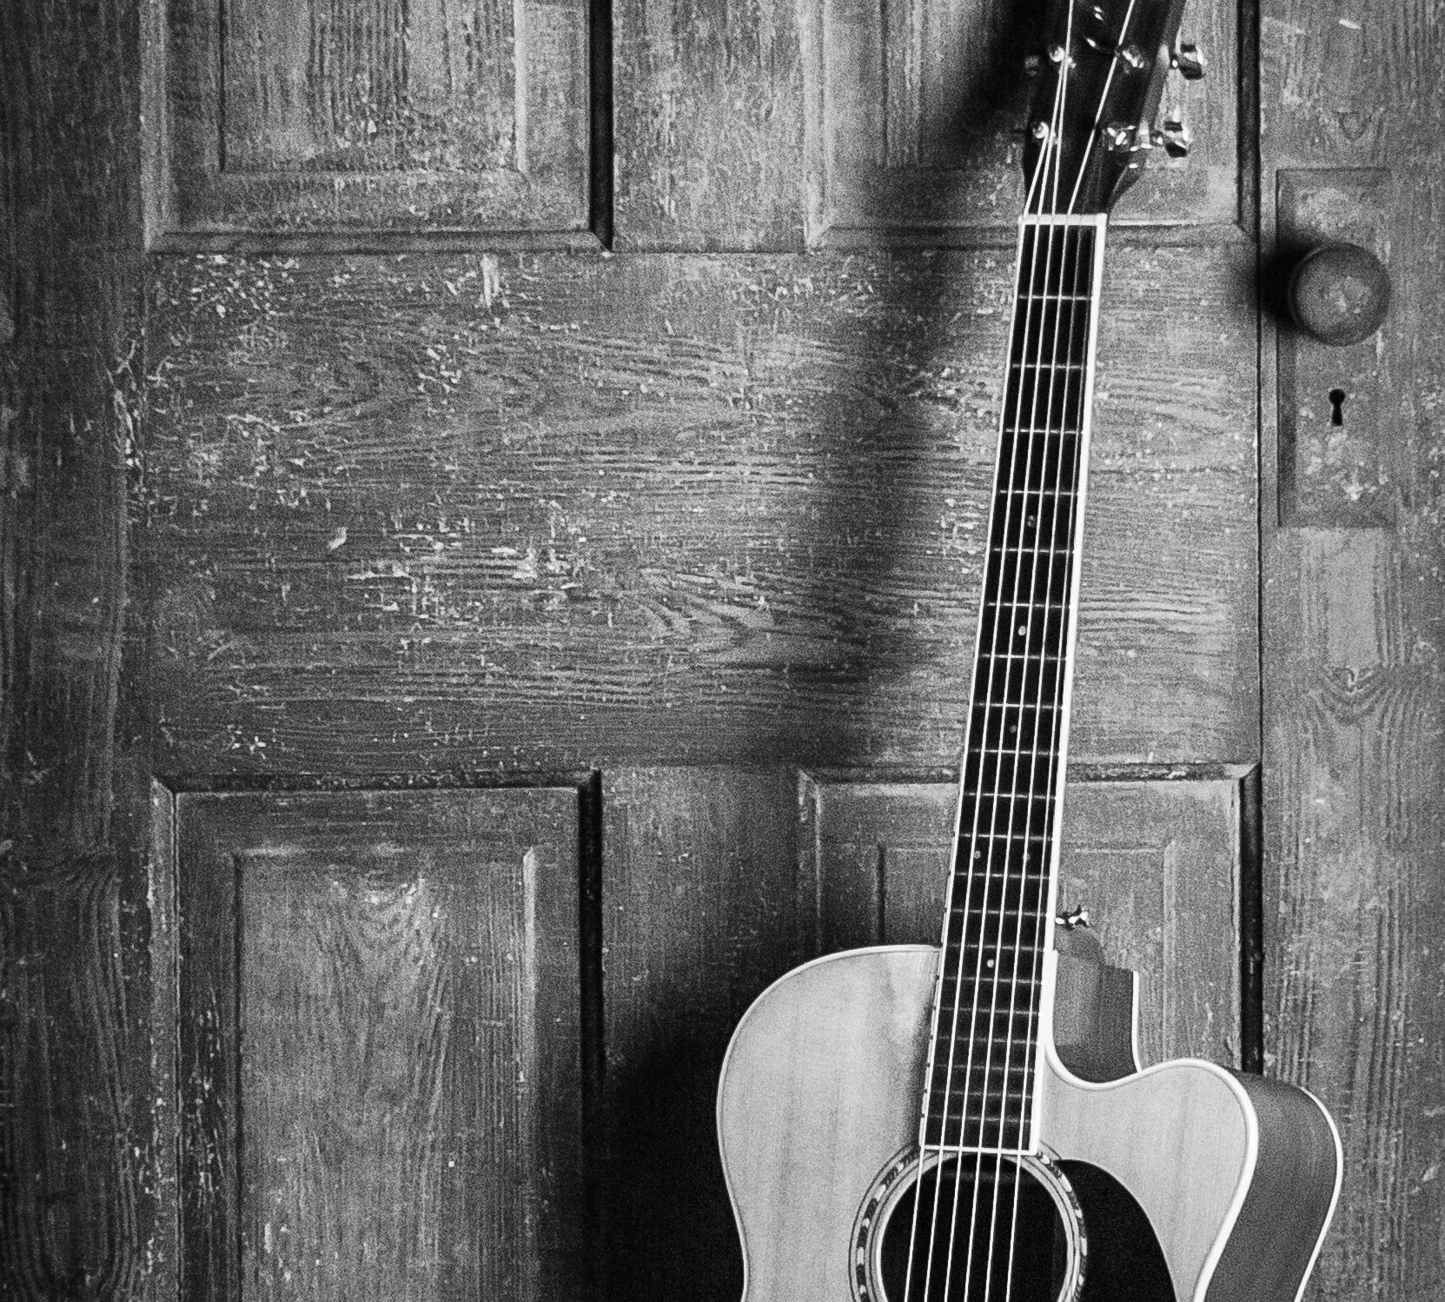
INTRODUCTION
In music, a note is the pitch and duration of a sound, and also its representation in musical notation (♪, ♩). A note can also represent a pitch class. Notes are the building blocks of much written music.
A chord, in music, is any harmonic set of pitches consisting of multiple notes that are heard as if they were sounding simultaneously. A musical note refers to the pitch class set of C,C#,D,D#,E,F,F#,G,G#,A,A#,B and the intervals between the notes are known as half-note interval or semitone interval. Thus chords can be seen as musical features and they are the principal harmonic content that describes a musical piece.

Slide 5
RELEVANT THEORY
FOURIER TRASNFORM
The Fourier transform (FT) decomposes a function of time (a signal) into its constituent frequencies. This is similar to the way a musical chord can be expressed in terms of the volumes and frequencies of its constituent notes.
The term Fourier transform refers to both the frequency domain representation and the mathematical operation that associates the frequency domain representation to a function of time. The Fourier Transform gives us a unique and powerful way of viewing these waveforms. The Fourier transform is important in mathematics, engineering, and the physical sciences.

Slide 6
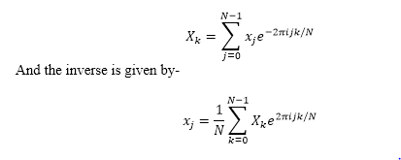
RELEVANT THEORY
Discrete Fourier Transform
The continuous Fourier transform converts a time-domain signal of infinite duration into a continuous spectrum composed of an infinite number of sinusoids. In astronomical observations we deal with signals that are discretely sampled, usually at constant intervals, and of finite duration or periodic. For such data, only a finite number of sinusoids is needed and the Discrete Fourier Transform is appropriate. The DFT of N uniformly sampled data points xj (where j=0,……,N-1 )

Slide 7
RELEVANT THEORY
Fast Fourier Transform
A Fast Fourier transform (FFT) is an algorithm that computes the Discrete Fourier transform (DFT) of a sequence, or its inverse (IDFT).
It is highly elegant and efficient algorithm, which is still one of the most used algorithms in speech processing, communication, frequency estimation, etc. one of the most highly developed are of DSP.
They are just computational schemes for computing the DFT

Slide 8
Fast Fourier Transform in MATLAB-
Syntax-
Y = fft(X)
Y = fft(X) computes the Discrete Fourier transform (DFT) of X using a fast Fourier transform (FFT) algorithm.
If X is a vector, then fft(X) returns the Fourier transform of the vector.
If X is a matrix, then fft(X) treats the columns of X as vectors and returns the Fourier transform of each column.
Y = fft(X , n)
Y = fft(X , n) returns the n-point DFT. If no value is specified, Y is the same size as X.
If X is a vector and the length of X is less than n, then X is padded with trailing zeros to length n.
If X is a vector and the length of X is greater than n, then X is truncated to length n.
If X is a matrix, then each column is treated as in the vector case.
Y = fft(X , n , dim)
Y = fft(X , n, dim) returns the Fourier transform along the dimension dim. For example, if X is a matrix, then fft(X,n,2) returns the n-point Fourier transform of each row.

Slide 9
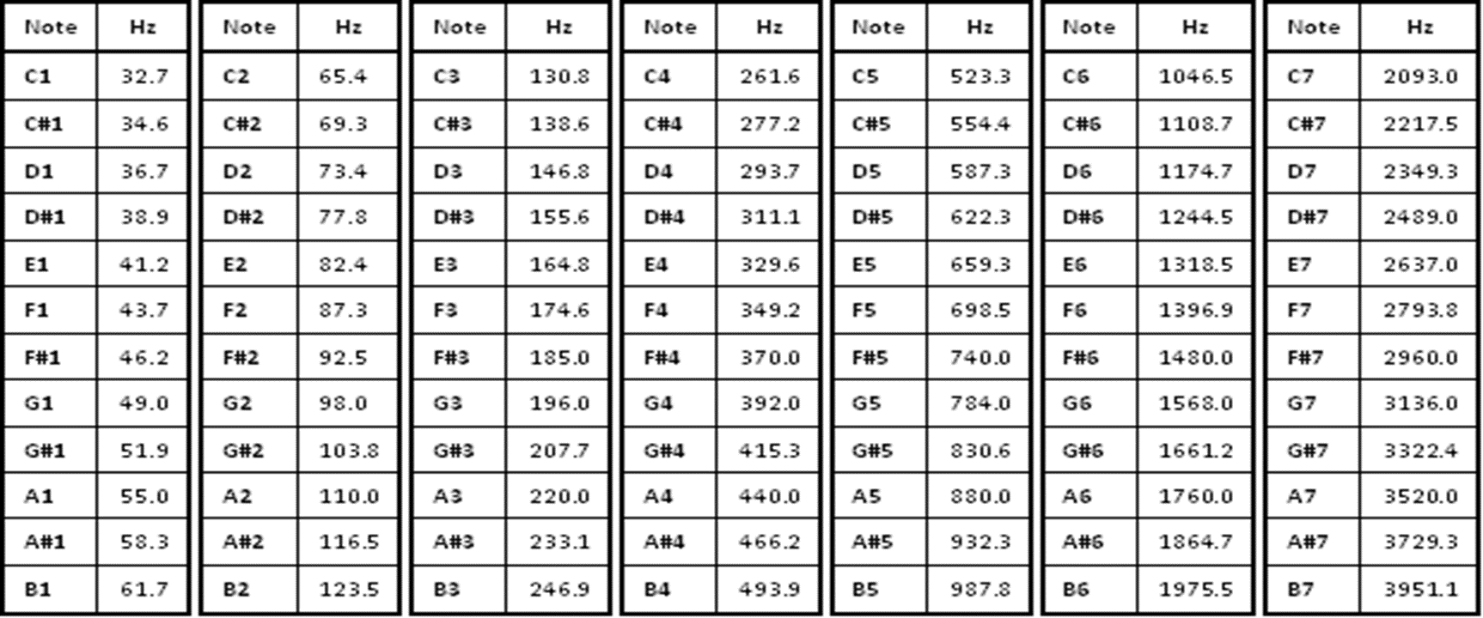
Following are some musical notes and their frequencies :-

Slide 10
OBJECTIVES
To understand the basics of musical notes and guitar chords.
To determine the Fast Fourier Transform of a guitar chord.
To plot the absolute value curve of FFT of guitar chords in MATLAB.
To determine the frequency from the plot of absolute value of FFT.
To determine the notes present in the given chord by the help of determined frequencies from the plot of absolute values of FFT.

Slide 11
METHODOLOGY
Record the sample guitar chords.
Gather data from the files like the sampling frequency, type of signal, gain, base and unit.
Change the sample chord to .wav format.
Now FFT of the chord is found out by the MATLAB program code written on the next page.
Then we plot the graph of FFT and find the absolute value of frequencies.
Now we compute the frequencies and tally them with the table given above of the musical notes and their frequencies.
This tells us which notes are present in the guitar chord sample.

Slide 12

PROGRAM CODE
>>[data,fs]=audioread(“filename.wav”)
>>data=data(1:1024)
>>N=16;
>>data=data(1:$2^{N}$);
>>figure(1)
>>clf
>>plot(data)
>>data1=data(1:$2^{N}$);
>>data1=data1’;
>>data1_fft=fft(data1,1024);
>>figure,plot(abs(data1_fft));

Slide 13
[peaks locs]=findpeaks(abs(data1_fft));
>>peaks
>>k1=locs(1)-1;
>>k2=locs(2)-1;
>>k3=locs(3)-1;

Slide 14
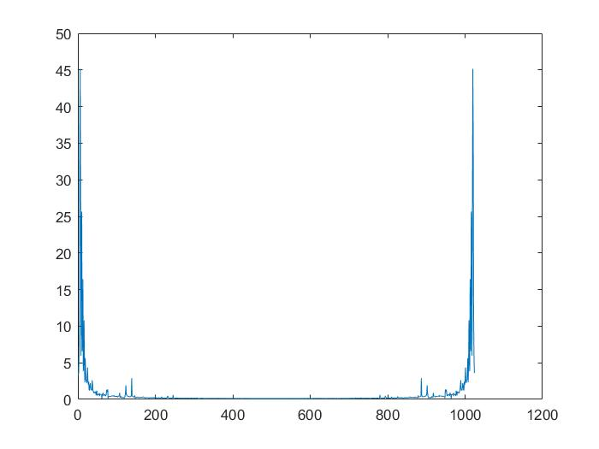
RESULT
E Major-
K1=4,k2=6,k3=10
Fs=22050
N=1024
w1=2π*4/1024=0.0245
w2=2π*6/1024=0.0368
w3=2π*10/1024=0.0613
f1=w1*22050/2π=85.97 Hz
f2=w2*22050/2π=129.14 Hz
f3=w3*22050/2π=215.33 Hz
On comparing the values of f1,f2 &f3 from table, the notes present in E Major are E,B,G#.

Slide 15
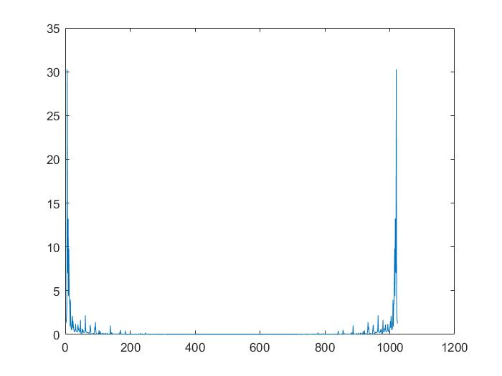
2) C Major
Similarly notes present in C Major are C,E & G.
3) A Major
Notes present in A Major are found to be A,C#,E.

Slide 16
CONCLUSION
In this we explore how MATLAB interact with sound and learn the detection of musical notes in guitar chords .
The FFT algorithm is found to be a good tool in context of guitar chords analysis and we successfully recognize the notes present in sampled guitar chords.
Fast Fourier Transform is algorithm which calculates the Discrete Fourier Transform of complex function in a very efficient way.

Slide 17
BIBLIOGRAPHY
https://en.wikipedia.org/wiki/Guitar_chord
https://en.wikipedia.org/wiki/Fourier_transform
https://www.mathworks.com/help/matlab/ref/fft.html#f83-998360-Y
https://en.wikipedia.org/wiki/Musical_note
https://www.britannica.com/science/Fourier-transform

Slide 18
Thank You.
DSP
Prakhar Paliwal
PROJECT 2018-2019
prakhar.paliwal01@gmail.com

